Slide 2
Omaha - Groundwater Assessment to Date
Omaha WWTP Consultative Group Point Wells Hall 28 Feb 2015
Alan Pattle / Aslan Perwick
Principal Hydrogeologist / Hydrogeologist
Pattle Delamore Partners Ltd
Auckland
solutions for your environment
PATTLE DELAMORE PARTNERS LTD

Slide 3
Starting Point - Omaha Flats
Some geology information from a number of registered bores in the area
Some groundwater information from monitoring bores

Slide 4
Investigations Completed – Omaha Flats
Coastline survey
‘Drain’ inspections
6x auger holes
~2 km of Ground Penetrating Radar (GPR) surveys
~600 m of Electro-Magnetic (EM) surveys
4x groundwater quality samples
Inform Conceptual Model
Completed as of Feb 2015

Slide 5
Geological Observations – Omaha Flats
Indications that peat/organic silts present at the surface across entire Omaha WWTP land area
Significant peat/organic silts present on air strip (Grice land)
Average peat/organic silt thickness ~5 m, typically varying from 2 m – 7.5 m

Slide 6
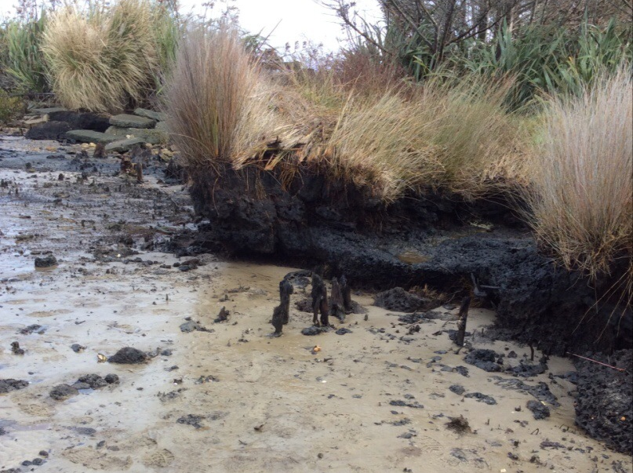
Peat Exposure – Omaha Flats Coastline

Slide 7
DRAFT – GPF Imagery

Slide 8
Groundwater Assessment – Omaha Flats
Drains likely to impart significant control of shallow groundwater. Configuration and flow important aspects to consider
Drains likely to be draining groundwater nearly all year round and have altered the natural groundwater flow regime
Some groundwater from beneath irrigation area could be captured by drains.

Slide 9
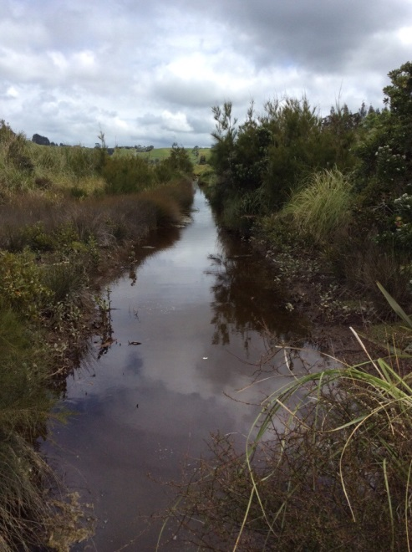
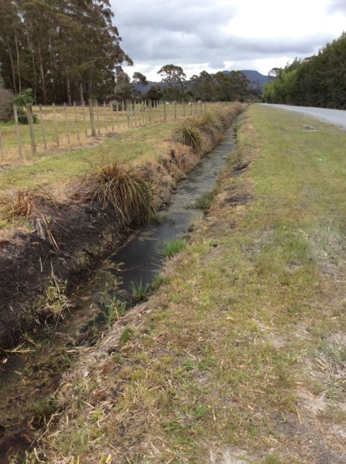
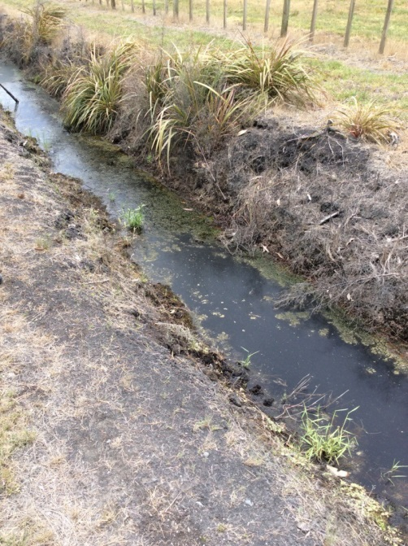
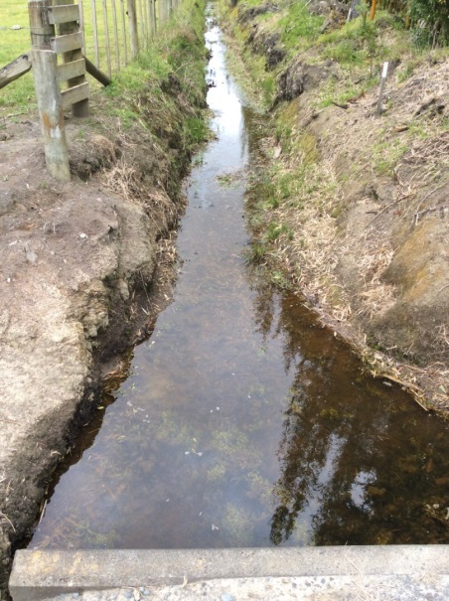
Drains at Omaha Flats

Slide 10
Groundwater at Omaha Flats
Shallow – typically within 1m of ground surface
‘Fresh’ (low salinity), slightly acidic
Indications of anoxic conditions
High concentrations of DOC
Low concentrations of contaminants of interest

Slide 11
Planned Works – Omaha Flats
Survey and monitor major drains in the vicinity of the Omaha WWTP
Hydraulic testing of groundwater monitoring wells on irrigation site
In-depth groundwater chemistry assessments
Update conceptual model with the new information
Update Conceptual Model

Slide 12
Mangatawhiri Spit

Slide 13
Mangatawhiri Spit – Starting Point
Some geology information and assumptions
Some groundwater level information

Slide 14
Investigations Completed – Mangatawhiri Spit
Coastline and site survey
‘8x auger holes
~2 km of Ground Penetrating Radar (GPR) surveys
~2.5 km of Electro-Magnetic (EM) surveys
1x groundwater quality sample (bore)
2x groundwater quality samples (beach)
Inform Conceptual Model
Completed as of Feb 2015

Slide 15
Geological Observations – Mangatawhiri Spit
Indications that sandy material present at the surface across the majority of the OGC irrigated area
Potentially some peat/high organic and/or clayey/silty layers or lenses, but small in comparison to the coverage of sand
Silt & sand mixtures, with appreciable organic content, dominant in top 2 m of geology west of the Kahikatea forest

Slide 16
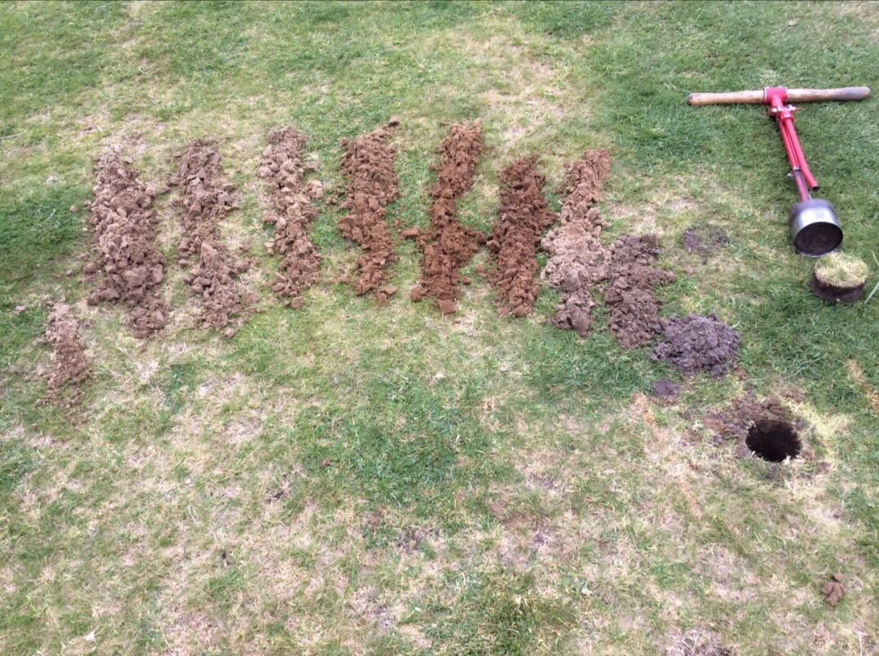
Hand Auger Returns – OGC

Slide 17
Groundwater at Mangatawhiri Spit - OGC
Shallow beneath OGC (~1-2 m bGL)
Deeper in high elevation dune areas (>4 m bGL)
‘Fresh’ (low salinity), slightly acidic
Oxidised conditions
Low concentrations of contaminants of interest

Slide 18
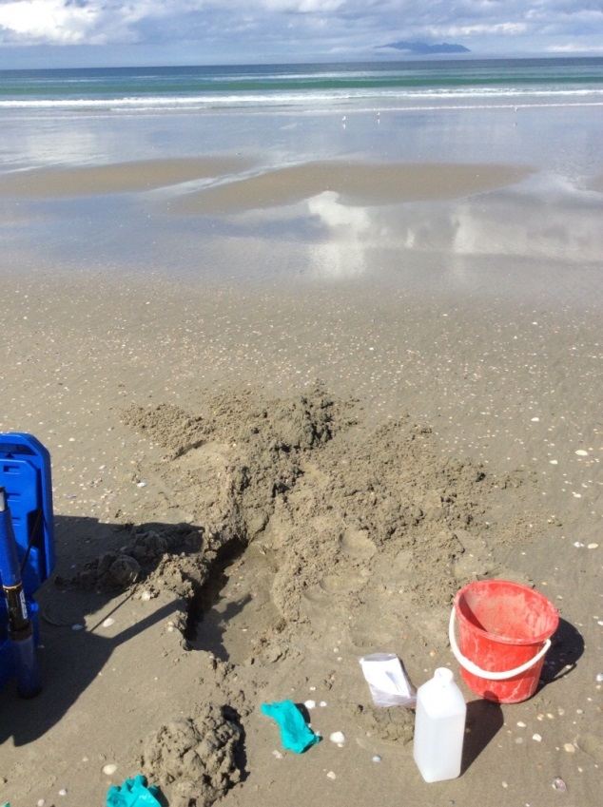
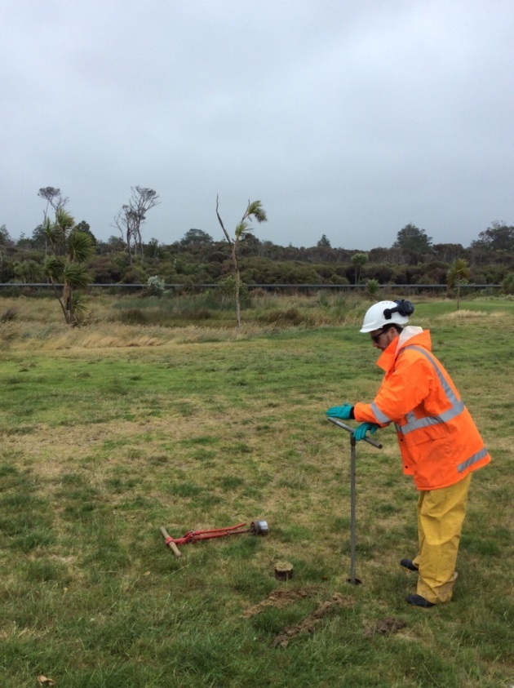

Slide 19
Planned Works – Mangatawhiri Spit
Planning and installation of additional monitoring bores
Hydraulic testing of existing and new groundwater monitoring wells
In-depth groundwater chemistry assessments
Update conceptual model with the new information
Update Conceptual Model

Slide 20
Thank you Q & A?

