Slide 1
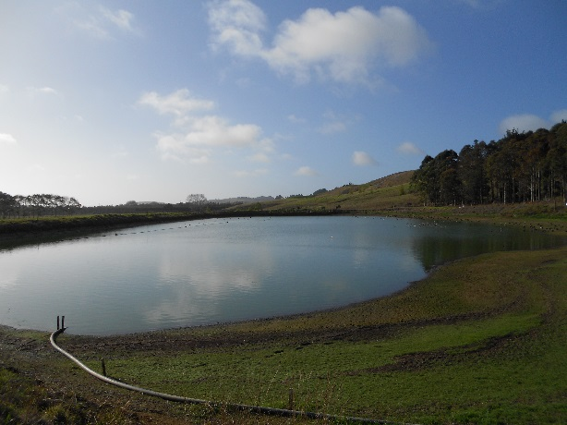
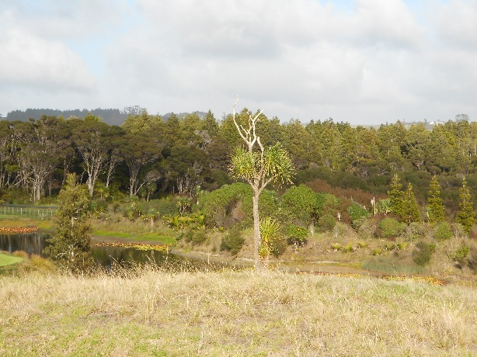
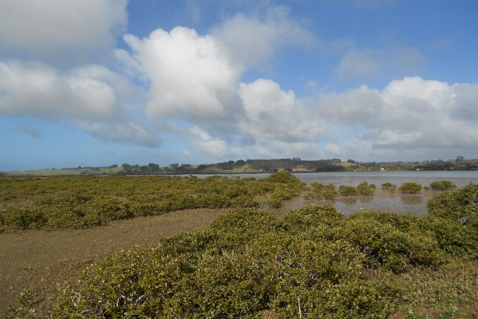
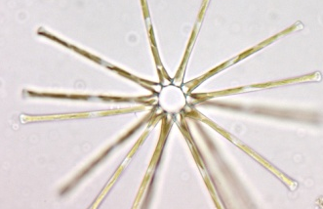
Investigation Plan for the Omaha WWTP – Stage One update
Dr Mark James, Aquatic Environmental Sciences Ltd
Notes:
ADD HORIZONS LOGO

Slide 2
Background
Sept/Oct 2014 - Review of existing knowledge -presentation and discussion with Consultative Group
Nov 2014 - Investigation Plan presented and discussed with CG
24 Nov 2014 - Site visit
Nov 2014 –Feb 2015 - Stage 1 underway

Slide 3
Monitoring of discharges
Compliance monitoring of discharge
Volume*, pH, dissolved oxygen, faecal coliforms (FC)*, suspended solids (TSS)*, CBOD*, ammonia, nitrate
FC <10cfu/100ml (consent 500)
TSS <20 mg/l (consent 20)
* Compliance limits

Slide 4
Monitoring of discharges
Drains surveyed 6 monthly – 4 drains Jones Rd
TSS and FC elevated in drains following rainfall but generally low and constant levels
Includes input from wider agricultural catchment
Bores surveyed 6 monthly – 4 at Jones Rd irrigation, 2 at edge of Golf Course (nitrite and DRP also measured here)
Faecal coliforms, ammonia and nitrate at Jones Rd higher closer to WWTP at times
No significant levels detected in bores at Golf Course (nitrate low but marginally higher 2012) – nitrate <5 g/m³, ammonia <0.5 g/m³

Slide 5
Nutrient processes and loadings – Stage 1
What are flow pathways, transformations and losses for nutrients in soils, wetlands, groundwater and final fate?
Tasks
Install 3-5 auger bores in transect from irrigated areas to Harbour, 3-5 depths (1-2m), 15 sites
Undertake Denitrifying Enzyme Activity assays – measures capacity for NO₃ N N₂O (need anoxia and available carbon)
Results
DEA highest generally in top 200mm, decrease with depth
Golf course – only top 200 mm had measureable DEA, deeper was fine-med sand and little organic material.
Jones Rd – DEA high, at all sites and depths (except closest to Harbour), other sources of leachate probable (eg fertiliser)
Conditions in and edge forest and salt marsh conducive to denitrification
Catchment loadings and relative input of WWTP uses old data – need to update

Slide 6
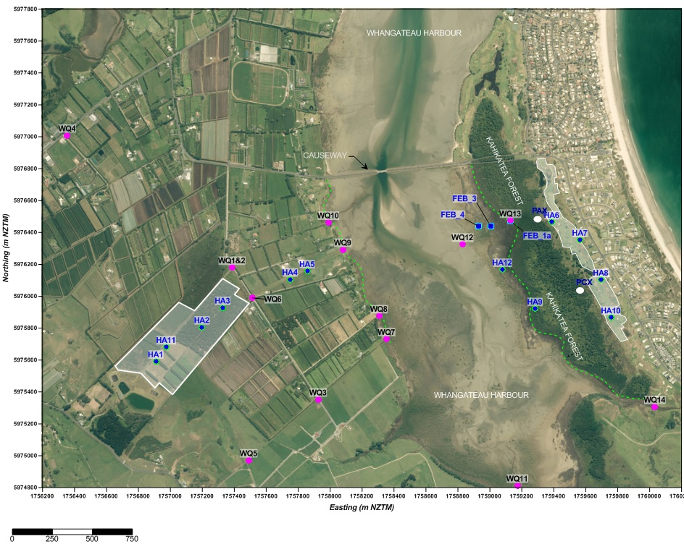

Slide 7
Nutrient processes and loadings
Stage 2:
Meeting of groundwater, nutrient processes experts to discuss sites, water quality sampling, control sites
Select key sites for further DEA based on flow pathways and hydrological models
DEA at additional sites that have been recently irrigated,
Potentially test removal at key sites in irrigation areas, nitrification rates, level of available carbon, assess efficacy of Jones Rd plantation.
Make recommendations on long-term monitoring
Complete analyses of nutrient loadings to Harbour when assays completed

Slide 8
Microbial and contaminants –Stage 1
Potential for microbial contamination, efficiency of the WWTP?
Planned start in late February
Review existing data and information
Site visit
Measure E.coli as part of surface water quality work (underway)
Review literature on UV treatment and efficacy
Assess potential tracers of septic tanks vs WWTP discharge
Measure key viruses in effluent (Stage 2?)
Emerging contaminants
Review underway
Lot of information about what is present, little information on environmental risk

Slide 9
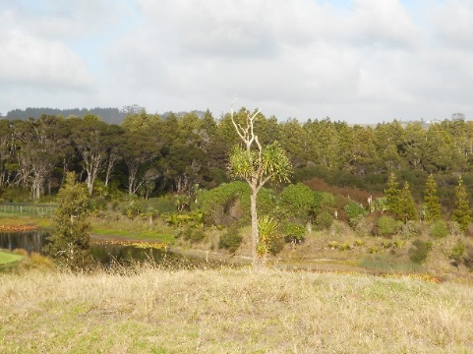
Wetland /Forests - Stage 1
Tasks:
Collate known information
Compile map showing extent of forest/wetland types
Conduct survey (little information available so survey conducted – Stage 2), recording vegetation, fauna
Results:
Omaha-Taniko complex best and most extensive sequence coastal wetland estuary in Auckland region, largest Kahikitea swamp in region
No indications of poor plant health, likely N limited
No surface water in forest/wetlands
Eels and mosquito fish and 16 bird species including fernbird recorded
Need more information on groundwater/nutrients

Slide 10
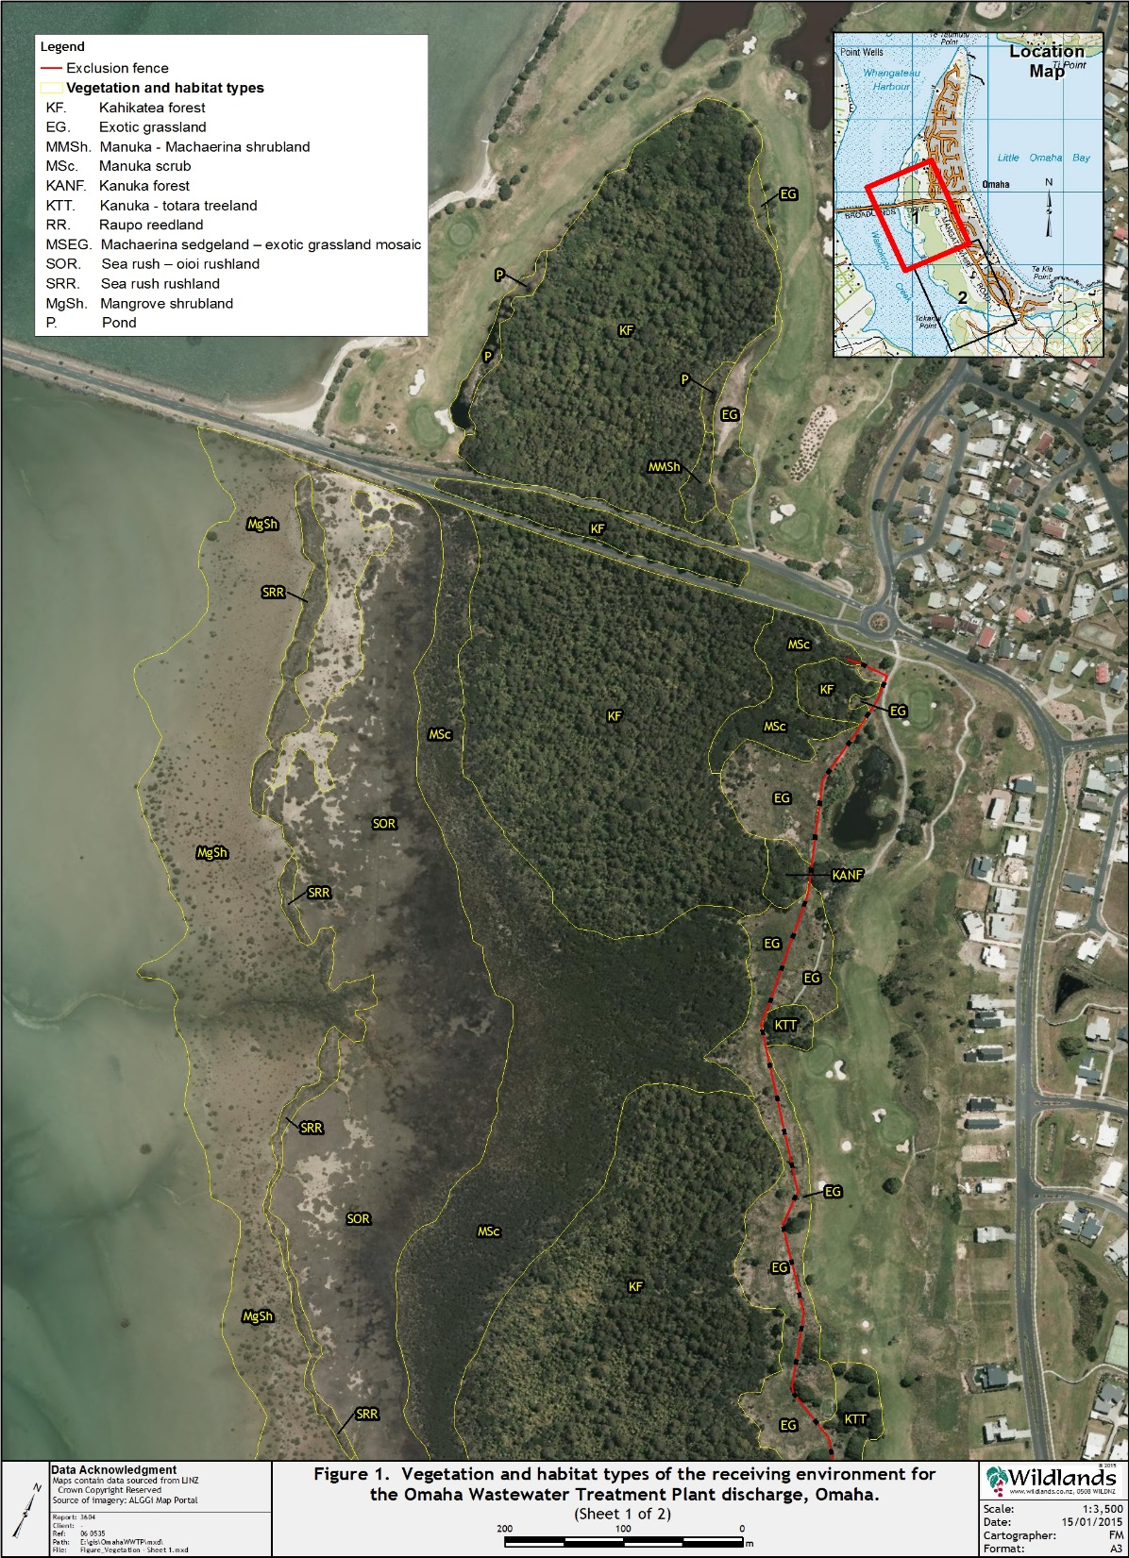
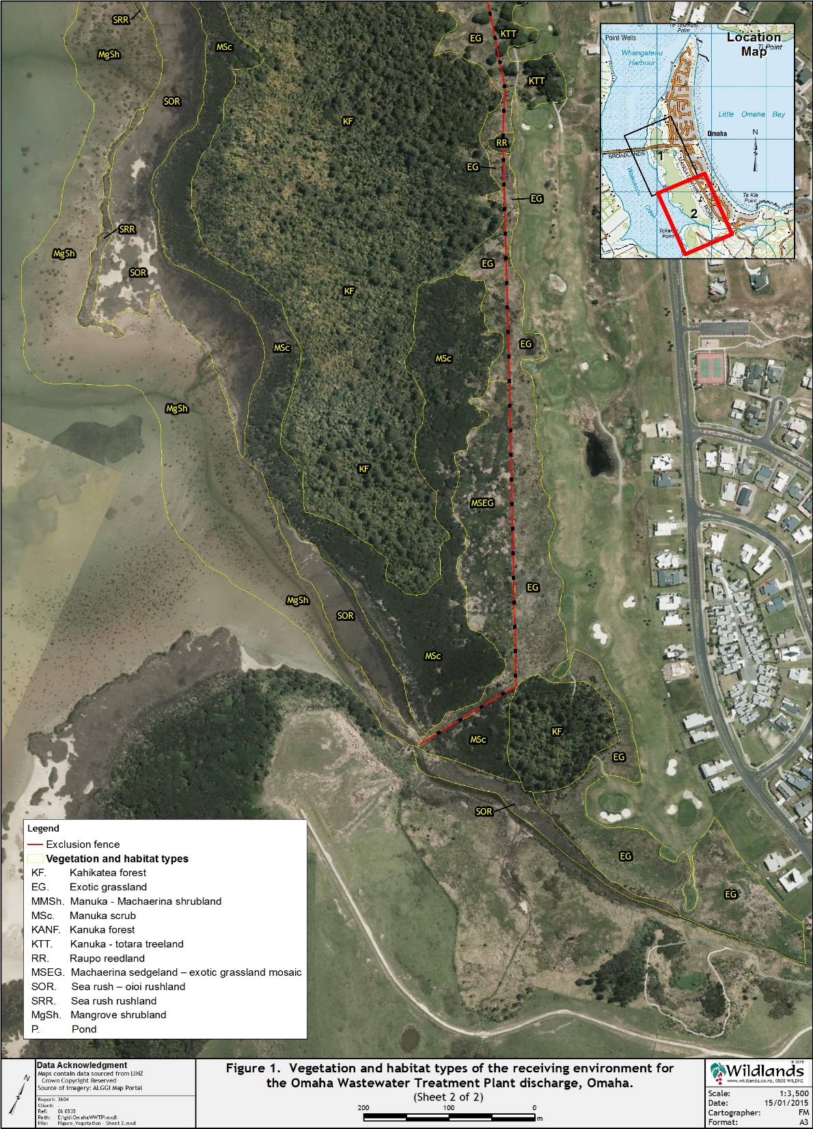
Forest/wetland – map to be inserted

Slide 11
Hydrodynamics
What are exchange rates with main harbour and open ocean?
Tasks:
Review existing information
If necessary develop a hydrodynamic model of circulation and dispersion
Results:
Hydrodynamic model completed
Waikokopu Arm almost entirely flushed each tide
Peak velocities 0.3 m/s on flood tide in Arm, for entrance 1.25-1.5 m/s.
Stage 2:
Add stream to model
Assess degree of exchange versus flushing from Harbour

Slide 12
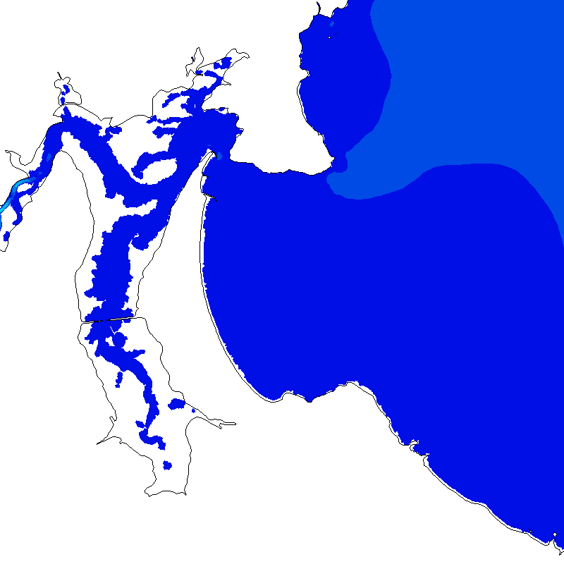
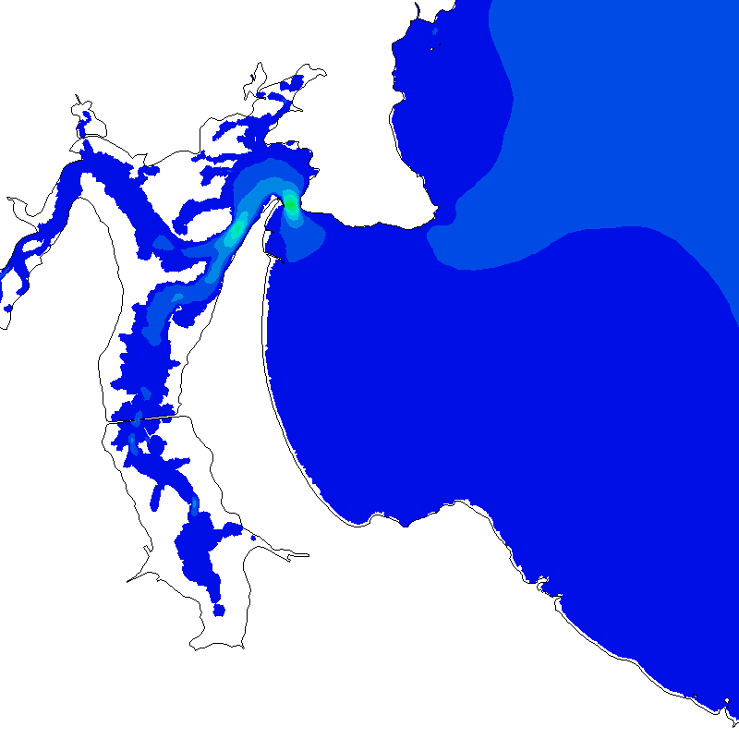
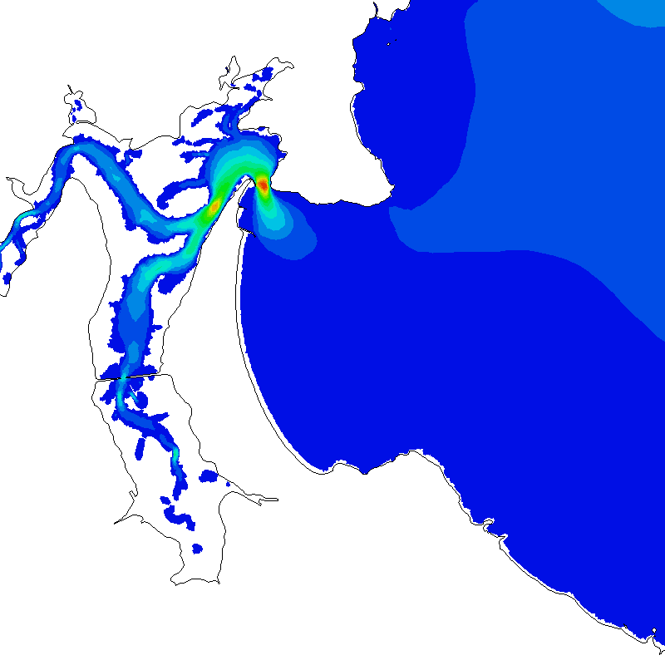
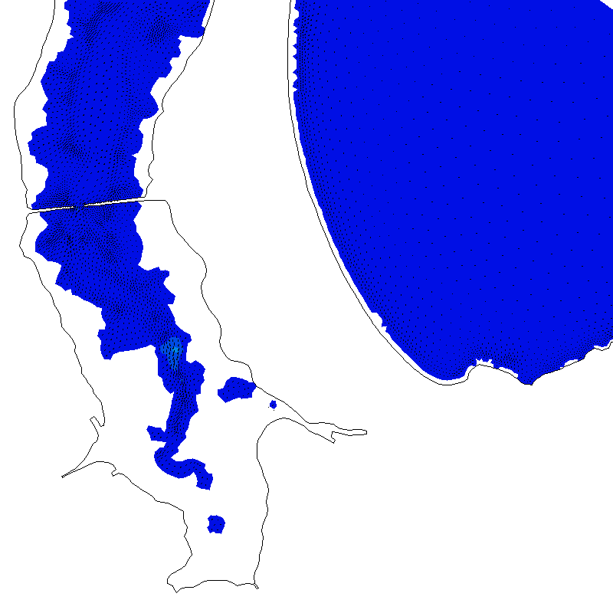
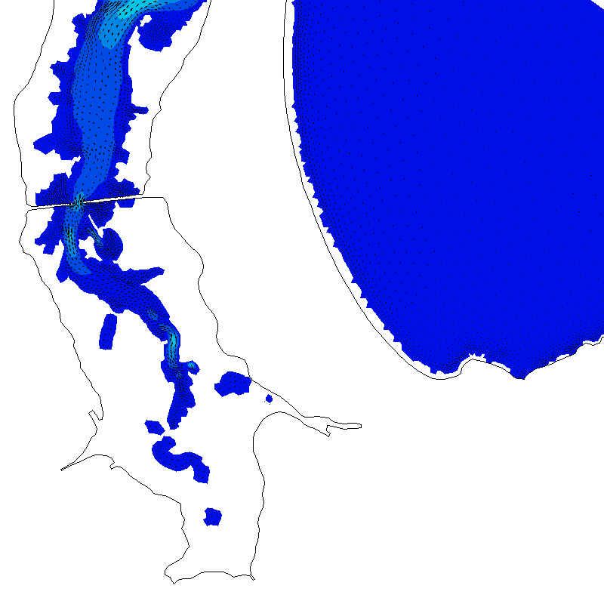
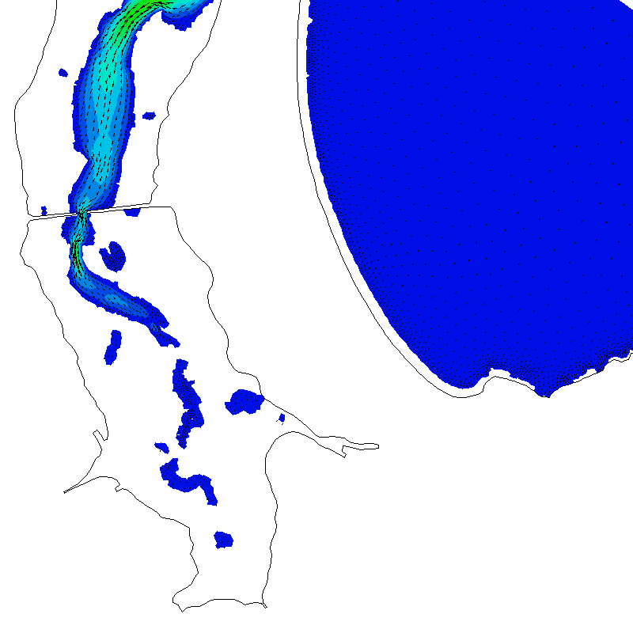
Hydrodynamics

Slide 13
Water quality surface waters – Stage 1
Obtain more information on water quality in surface waters
Tasks:
Collate data for Ti Point since 1991
Initiate sampling at Causeway
Survey water quality of surface waters
Results:
Monthly sampling at Causeway started in July 2014
Total phosphorus and chl a at Ti Point had increased to 2007 but recent data shows a decrease since then
Data from Causeway the same or similar to Ti Point
Harbour in “good” condition (AC trends) possibly “excellent”.

Slide 14
Water quality surface waters – Stage 1
AC initiated monitoring at 5 sites in Whangateau weekly over 2014/15 summer (TN, TP, E.coli, Enterococci and faecal sources), Watercare added 6 more sites around Pt Wells.
Monitoring at 14 sites close to irrigation areas, controls and inputs to Harbour started in January 2015. Nutrients mostly low levels. Some sites no water or stagnant.
Stage 2:
Analyse data and assess state of surface waters after 2-3 months, including new data from AC.

Slide 15
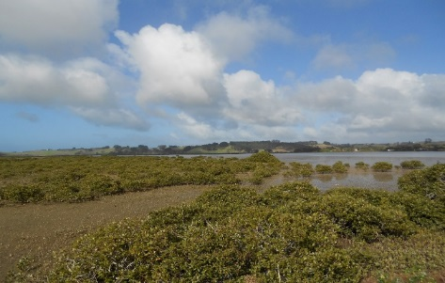
Benthic habitats – Stage 1
What is present status of benthic habitats in Arm?
Tasks:
Review existing information, especially Auckland Council data
Collate and analyse AC data for Waikokopu Arm
Map changes in habitat and communities
Results:
Monitoring conducted 6 monthly at 4 sites in Arm
No trends over time and populations variable, dominated by bivalves, polychaetes, amphipods and gastropods
Metals at low levels
Shape and extent of mangrove and seagrass patches have changed in some places
Stage 2:
Recommend assessment of state of cockles, mangroves with regard to nutrient limitation, sensitivities to enrichment

Slide 16
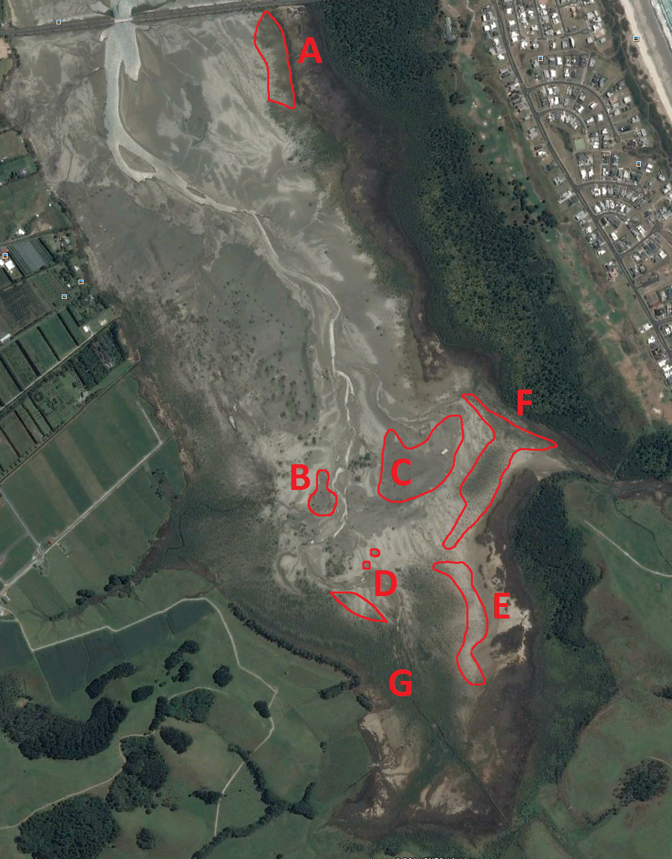
A - Backfilling by mangroves
B – Seagrass expanding northwards
C – Expansion of seagrass patches
D – Seagrass patches expanded, mangroves expanding seaward
E – Backfilling with scattered mangroves
F – Mangroves expanded
G – increase in mangroves

Slide 17
Fish and birdlife – Stage 1
What is present state of bird and fish life in Harbour?
Tasks:
Review existing information
If lack of information consider further surveys
Results:
Evident that Whangateau is one of most important estuaries in Auckland region, diverse bird and fish populations
33 shorebirds and saltmarsh birds recorded including 9 threatened species and 10 “at risk” in Harbour including 22 in Waikokopu Arm, important feeding ground for a number of species including NZ Fairy Tern (spit)
Stage 2:
Over 10 years since last surveys, recommendation is to undertake a further survey this summer, before emigrating birds depart.

Slide 18
Stage 3 – work plan
Assessment of effects
Flow pathways and groundwater models
Nutrient pathways, transformations and fate
Microbial contaminants (including ECs) and potential risks
Water quality of inputs in context of harbour, national standards
Potential effects on forest/wetlands
Potential effects on benthic habitat, birds, fish
Monitoring plan, potential mitigation if required

Slide 19
Auckland Council Review – key points
Expect groundwater modelling, nutrient balance and fate (covered in Stage 2)
Nutrient processes – most of N in effluent is ammonia so need to include nitrification in soils (added to Stage 2)
Groundwater – flows and direction important, include monitoring data from bores(covered in Stage 2 and 3)
Microbial contamination – expect some comment on emerging contaminants (Stage 1), review of E.coli (Stage 1), efficacy of removal of viruses, assess risk of viruses not just adenovirus, consider Microbial Risk Assessment (covered if necessary in Stage 2)

Slide 20
Auckland Council Review – key points
Nutrient loads need to be reassessed (covered in Stage 1)
Wetlands – important to assess effects, water sampling close to wetlands (covered in Stage 1 and 3)
Hyrodynamics - need to assess flushing (Stage 1)
Benthic habitat – updated survey required, nutrient effects (Stages 1-3)
Midges, fish and birds - ok

